Slide 1
TCP Vegas
Kulan Kao
2006/3/25

Slide 2
TCP Vegas
Proposed by Brakmo and Peterson in 1995.
Congestion control algorithm: using RTT time to measure the network situation.
Compare the expected efficiency and actual efficiency to decide whether increasing or decreasing the cwnd value.

Slide 3
TCP Vegas
There are three ways proposed in Vegas to increase delivery throughput and decrease packet loss.
  Modified Slow-Start Mechanism
  New Congestion Avoidance Mechanism
  New Retransmission Mechanism

Slide 4
TCP Vegas
Modified Slow-Start Mechanism
Limited Slow-Start Mechanism
To be able to detect and avoid congestion during slow-start, Vegas reduce the increasing rate of cwnd.
Cwnd is allowed exponential growth only every other RTT. (doubles the size of cwnd every 2 RTT time while there are no losses).
In between, the cwnd stayed fixed so a valid comparison of the expected and actual rate can be made.
When the actual rate falls below the expected rate by a certain amount - the γ threshold - Vegas changes from slow-start mode to linear increase/decrease mode.

Slide 5
TCP Vegas
Modified Slow-Start Mechanism
By limiting the maximum increase in the cwnd in a round-trip time, Limited Slow-Start can reduce the number of drops during slow-start, and improve the performance of TCP connections with large congestion windows.
When Vegas detect there is queuing in network , the queue length exceed γ,and the actual rate falls below the expected rate, Vegas will change its state from slow-start mode to congestion avoidance mode, and set cwnd to 7/8 of current value.

Slide 6
TCP Vegas
New Congestion Avoidance Mechanism
TCP Reno congestion control mechanism decide whether the network is congested or not by detecting the packet loss.
As a result, TCP Reno will increase the size of window until packet loss happens, so Reno will face packet loss problem periodically.
TCP Vegas has another New Congestion Avoidance Mechanism to control the size of cwnd by observing the variation of RTT.
When the sender receives an ACK, Vegas calculate the difference between the expect send rate and the actual send rate.

Slide 7
TCP Vegas
New Congestion Avoidance Mechanism
Vegas defines two thresholds, α and β, and Diff = Expected send rate – Actual send rate
Expected send rate= Windowsize / BaseRTT
Actual send rate= (the bytes transmitted between the time that the segment is sent and its ACK is received) / (the Segment’s RTT)
BaseRTT is the minimum of all measured RTT, that is updated if the Diff < 0.

Slide 8

TCP Vegas
When Diff < α, Vegas increase the cwnd linearly during next RTT, and when Diff > β, Vegas decrease the cwnd linearly during the next RTT.
Vegas leaves the cwnd unchanged when α < Diff < β. The default value of (α, β) is (1,3).
TCP Vegas parameters

Slide 9
TCP Vegas
New Retransmission Mechanism
Vegas improved the Fast retransmit mechanism in order to detect packet loss earlier and retransmit immediately.
1.When a duplicate-ACK is received, Vegas checks if the RTT time, which is the difference of the current time and the timestamp recorded for the relevant segment, is greater than the timeout value. If it is, Vegas retransmit the segment immediately without 3 duplicate-ACKs.

Slide 10
TCP Vegas
New Retransmission Mechanism
2.When a non-duplicate ACK is received, if it is the first second one after a transmission, Vegas again checks if the time interval since the segment was sent is larger than the timeout value. If it is, retransmit the segment.
3.Vegas only decreases the cwnd if the retransmitted segment was previously sent after the last decrease.

Slide 11
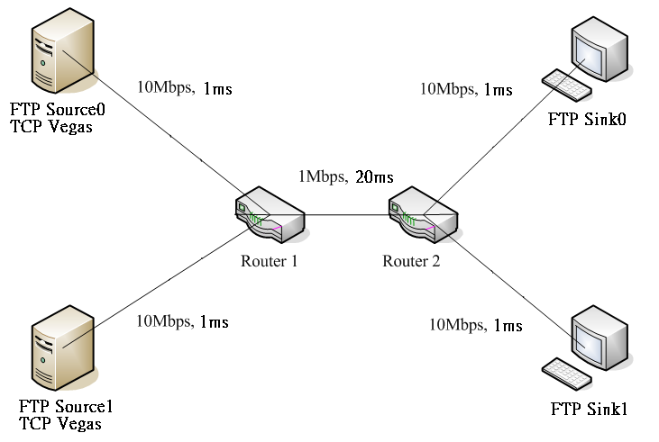
Exp10_1
TCP Vegas vs. TCP Vegas

Slide 12
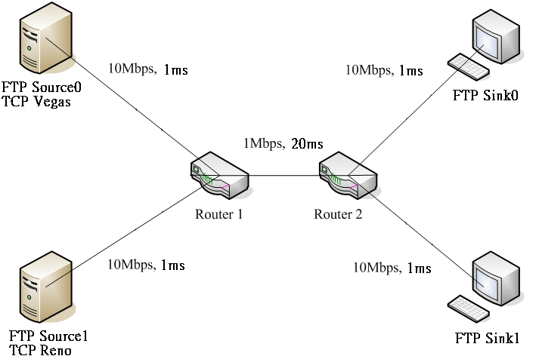
Exp10_2
TCP Reno vs. TCP Vegas

Slide 13
Exp10_2
TCP Reno vs. TCP Vegas
Advantages: In the Congestion Avoidance stage, Vegas can adjust cwnd efficiently according to the bandwidth, thus reduce packet lost, and improve the throughput under the effect of retransmission and timeout.
TCP Vegas achieves between 40% and 70% better throughput and one-fifth to one-half the packet loss, when compare with TCP Reno.
Disadvantages: 因為Vegas保守的搶buffer策略, 使它在與Reno共存的網路環境時, 當buffer數目小時, 可以比Reno有好的throughput, 當buffer數目增加時, 會使得大部份的buffer被Reno搶走, 所以不適合與其它的TCP共存.

Slide 14
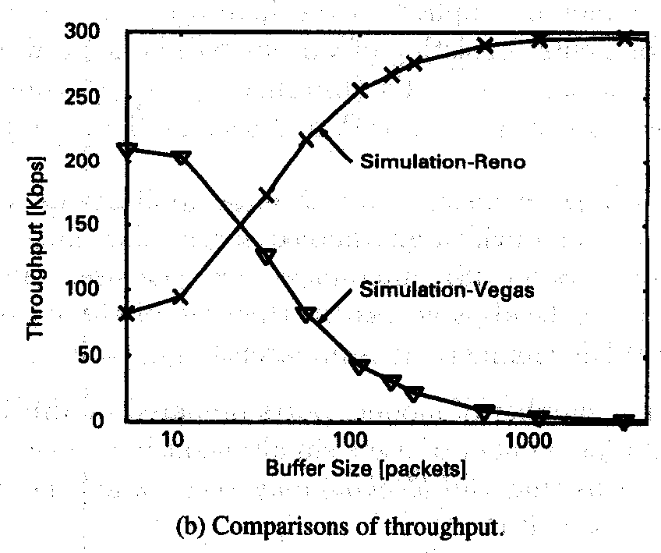
Exp10_2
TCP Reno vs. TCP Vegas

